Slide 1
This Week Work Progress
Lecturer：SUSTech Li Yuchen
2019.3.14

Slide 2
content
01
Kaggle
02
Mis-Classification analysis
03
Studying machine learning & Tensorflow

Slide 3
Kaggle
Part One
01

Slide 4

Kaggle-Diabetic Retinopathy Detection

Slide 5
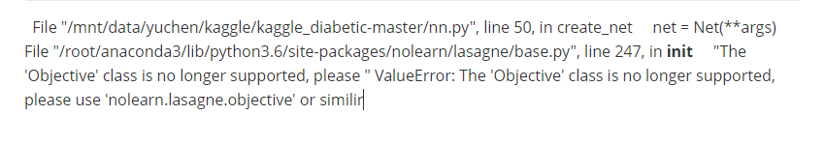
Recurring Paper
O_o team Code
Unsuccessful
Reason anlysis:
1. the code is old, some codes are not fit for server environment.
2.the code is using theano, not tensorflow

Slide 6
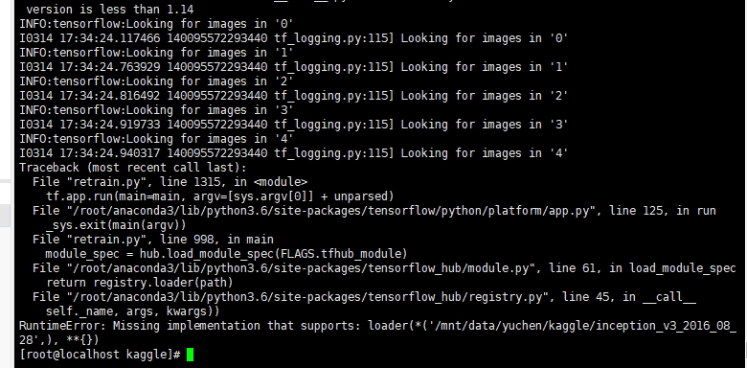
Tensorflow Hub transfer learning
Running it on my computer now.
The server couldn’t download the model from tfhub.dev. I am try to connect model manually.

Slide 7
Image Quality Evaluation
Part Two
02

Slide 8
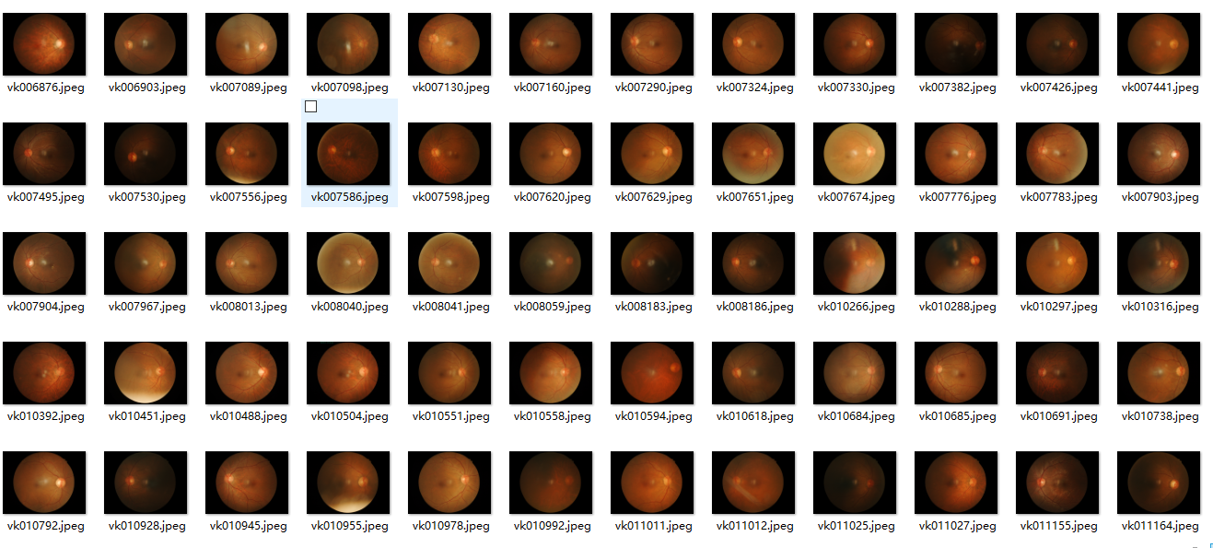
MISCLASSIFIED TEST IMAGES
Training for 3 times, throw away the misclassified images, every time divide dataset 10% for test,10% for validation
Test Accuracy
75.1% (1439) | 92.4% (1105) | 95.4% (997)

Slide 9
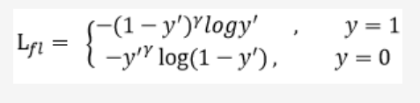
Focal loss
focal loss主要是为了解决one-stage目标检测中正负样本比例严重失衡的问题。该损失函数降低了大量简单负样本在训练中所占的权重，也可理解为一种困难样本挖掘。

Slide 10
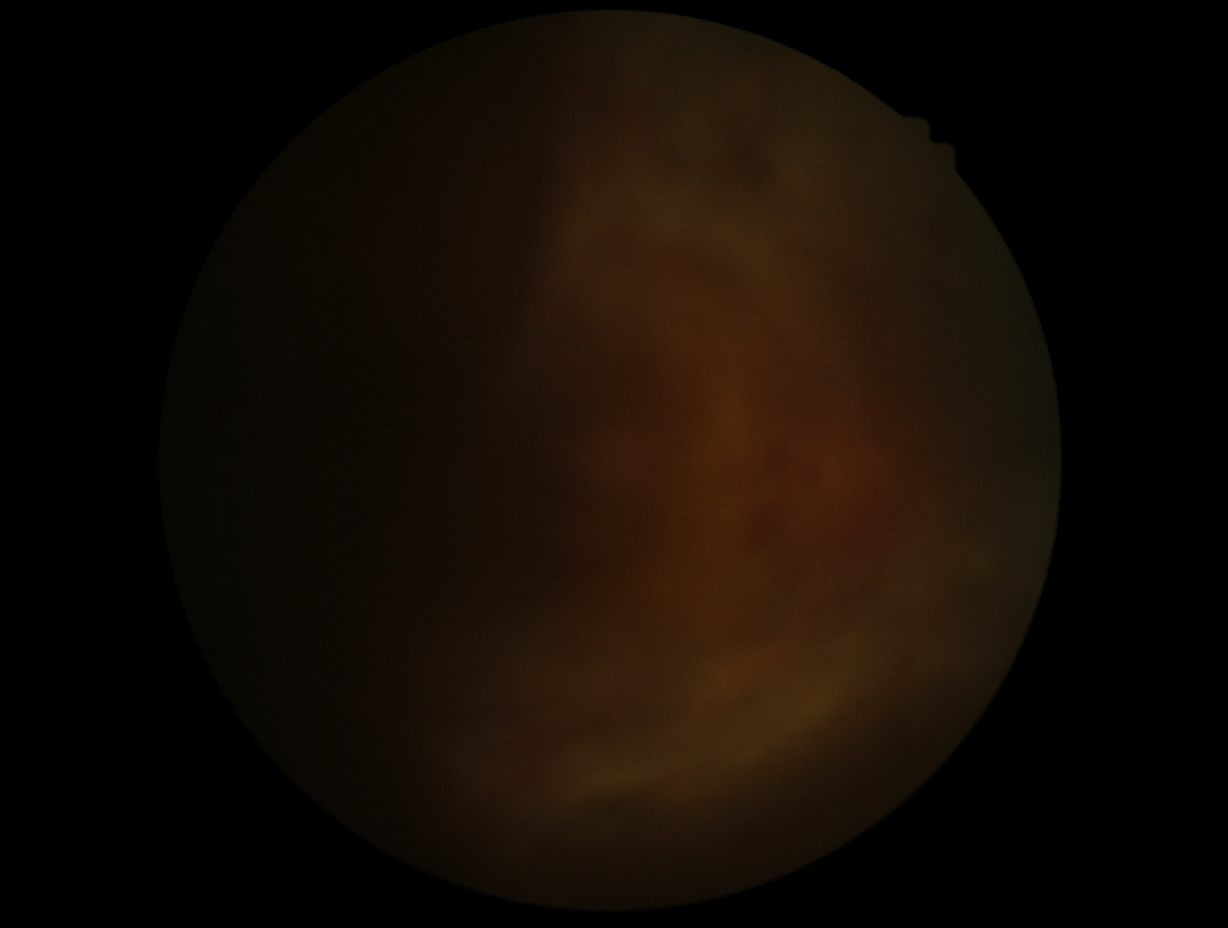
Mis-Classification Analysis
1. Some of the images are too dark (DR->DM)

Slide 11
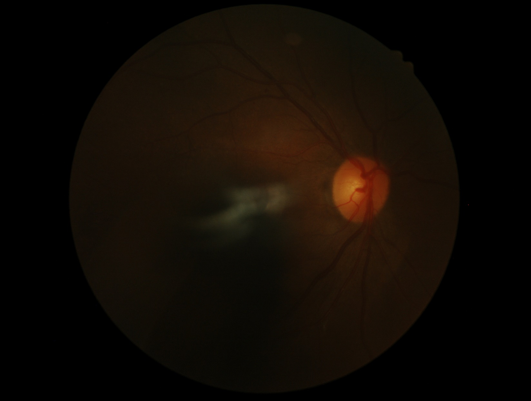
Mis-Classification Analysis
1. Some of the images are too dark (DR->DM)

Slide 12
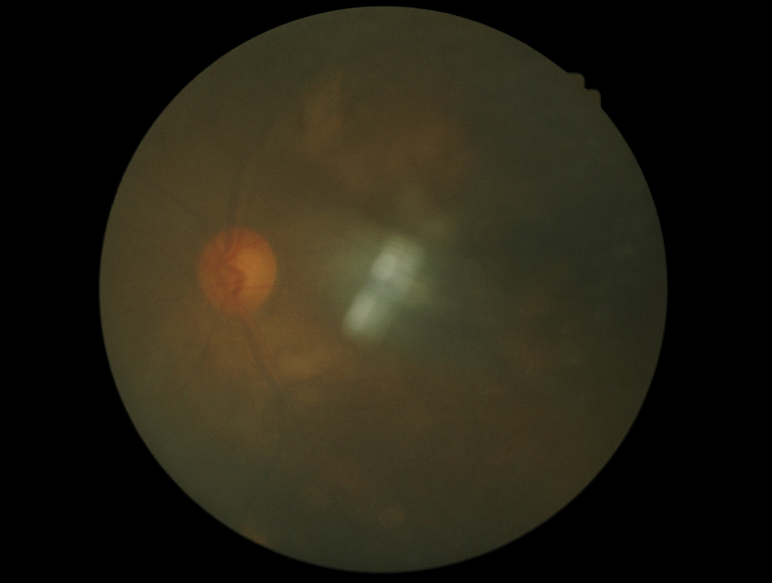
Mis-Classification Analysis
1. Some of the images are too dark (DM->DR)

Slide 13
Mis-Classification Analysis
1. Some of the images are too dark (DM->DR)

Slide 14
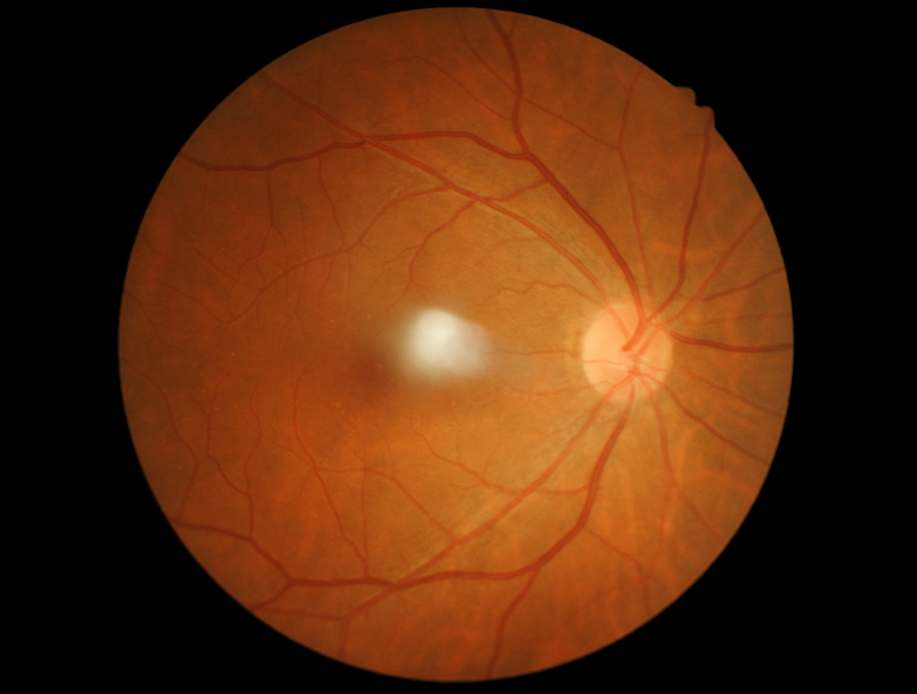
Mis-Classification Analysis
2. Some of the images are few (DM->DR)

Slide 15
Study
Part Three
03

Slide 16
Future plan
01
Analyze the reasons & find questions
02
Try the methods
02
Study

Slide 17
THANKS
And Your Slogan Here.

